Slide 1
welcome to Riverside
The highlights
Sarah’s picks
Please click on the volume icon to hear audio
Notes:
Presenter notes
A slideshow of some of Learning Assistant Sarah favourite objects from the Riverside Museum. Please click on the volume button to hear audio.

Slide 2
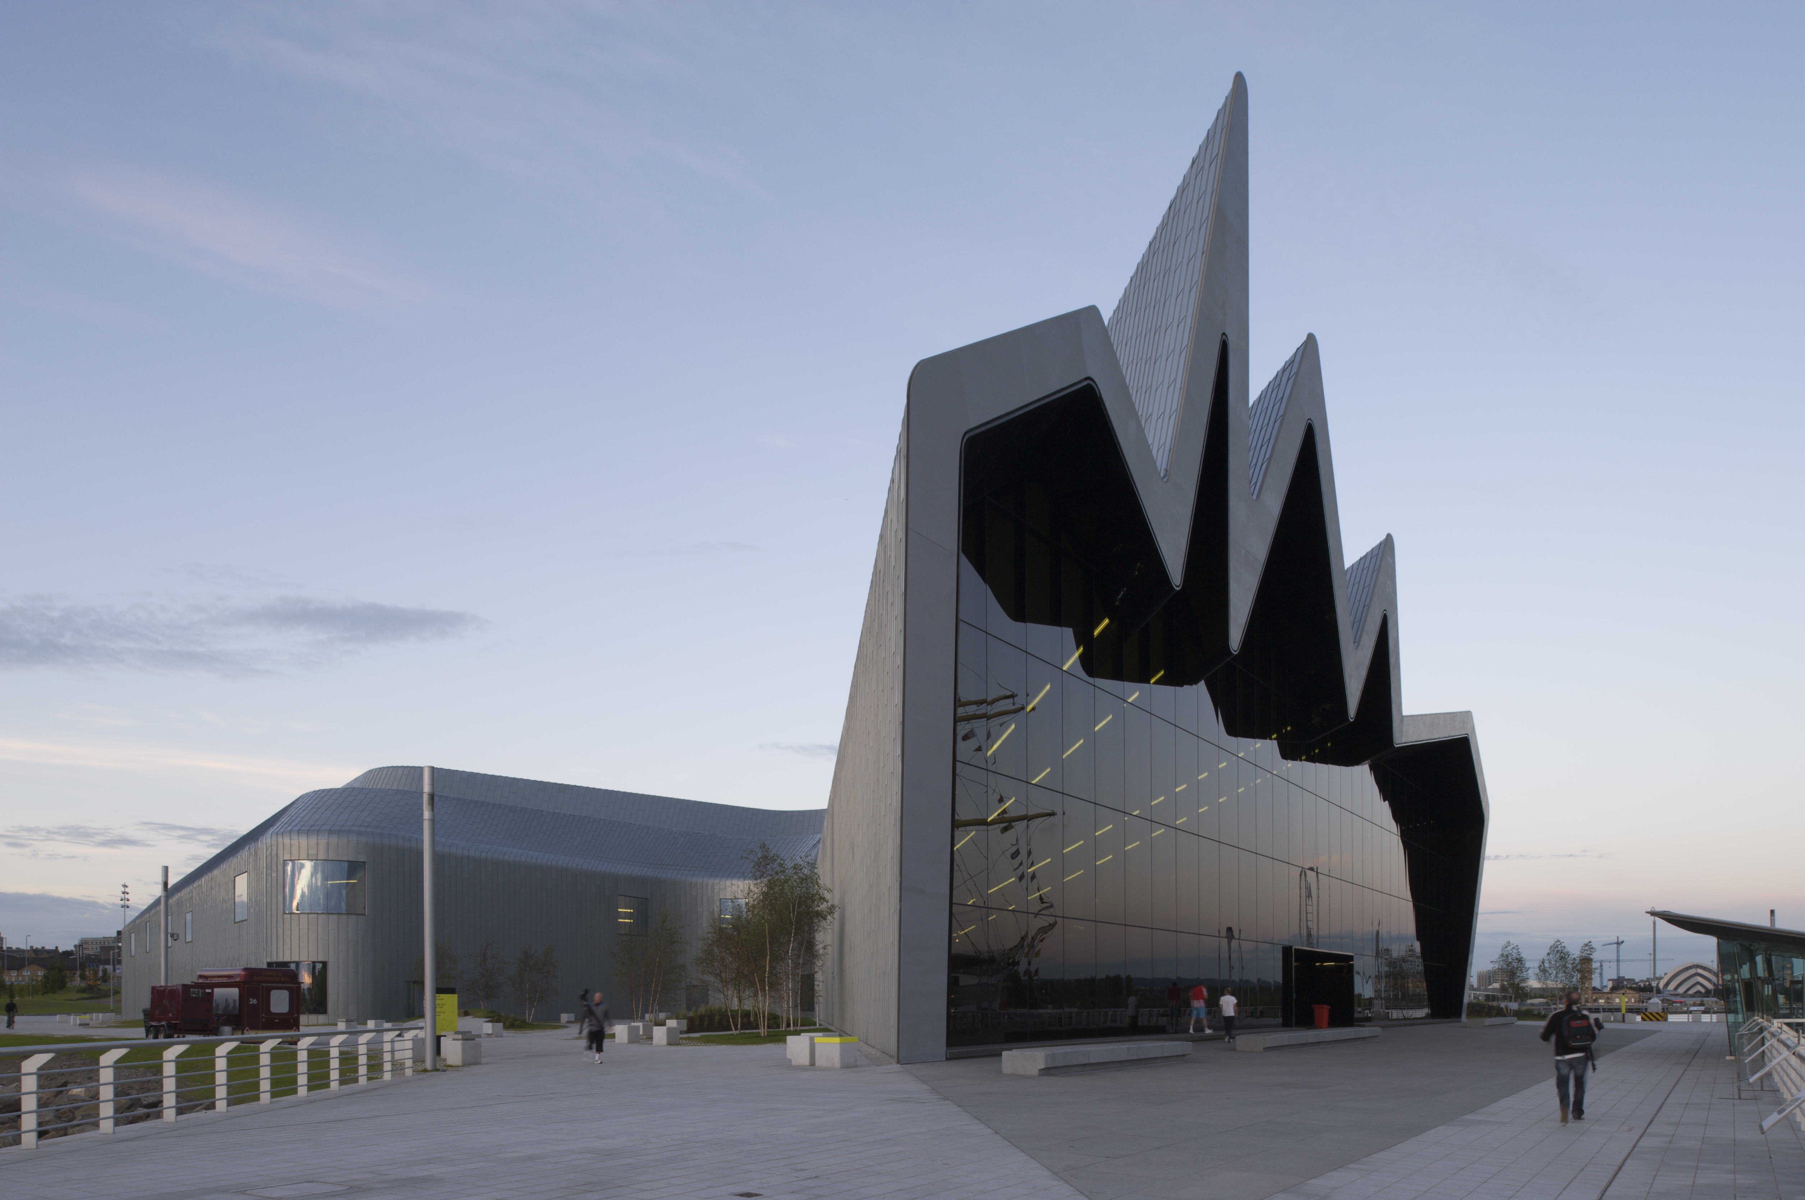
The Riverside Museum
Exterior
Please click on the
volume icon to hear audio

Slide 3
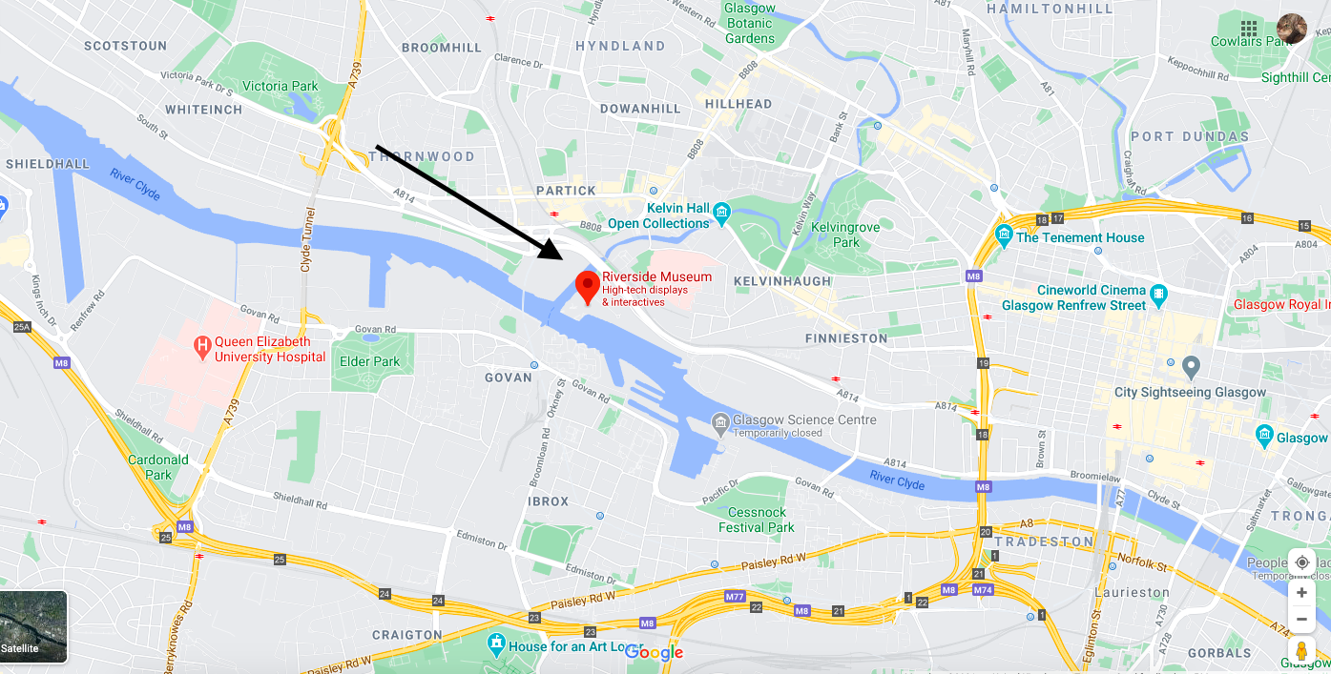

Slide 4
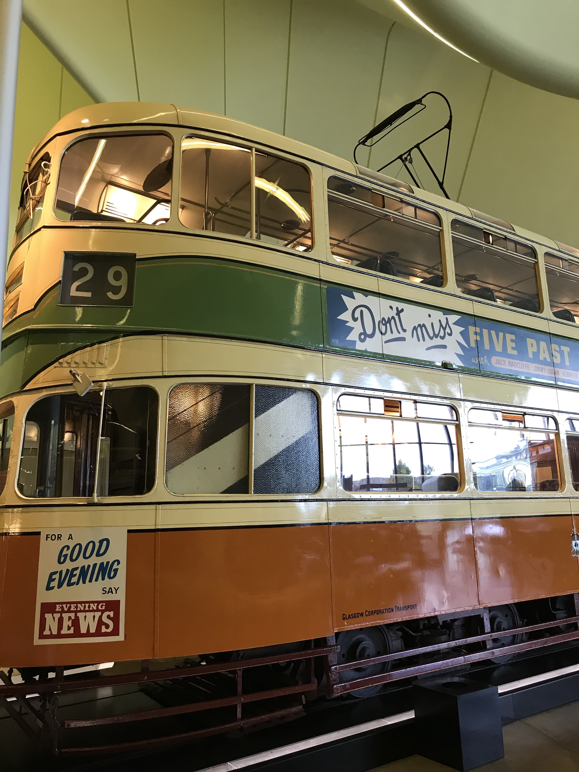
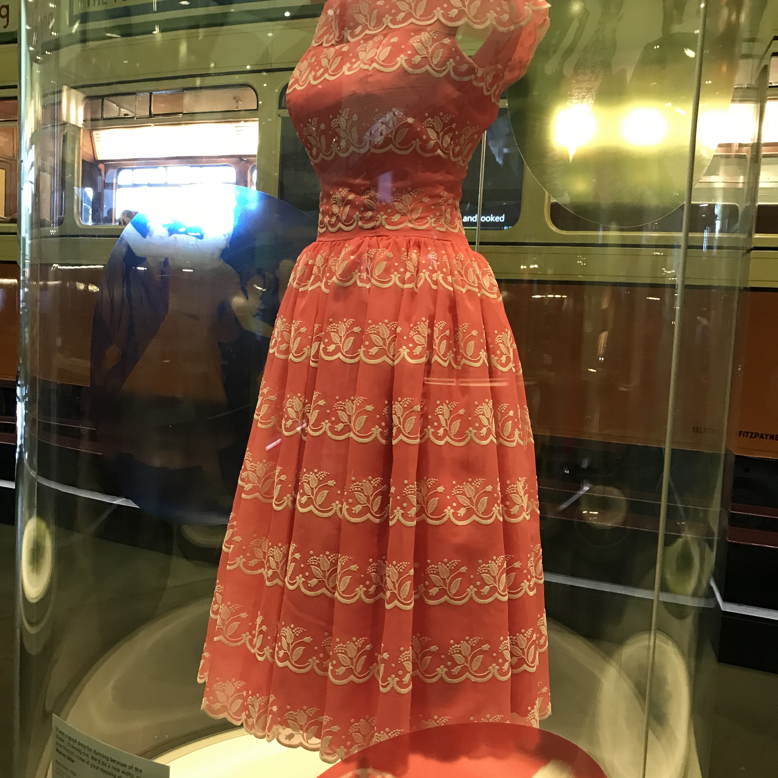
Tram Dancing Display
This is Cunarder tram
1392.
Please click on the
volume icon to hear audio

Slide 5
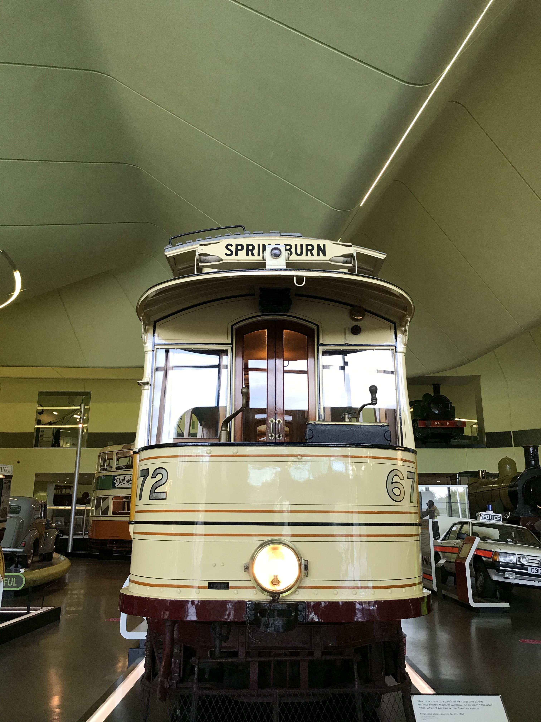
Room
&
Kitchen Tram
Please click on the
volume icon to hear audio

Slide 6
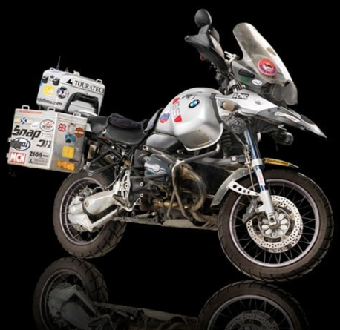
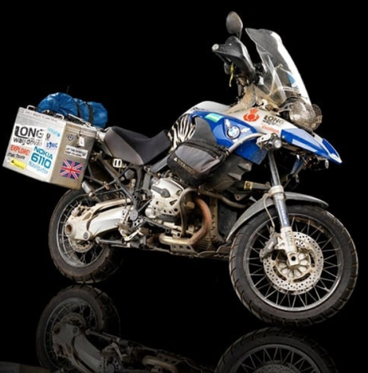
Ewan McGregor’s
Motorbikes
Please click on the
volume icon to hear audio

Slide 7
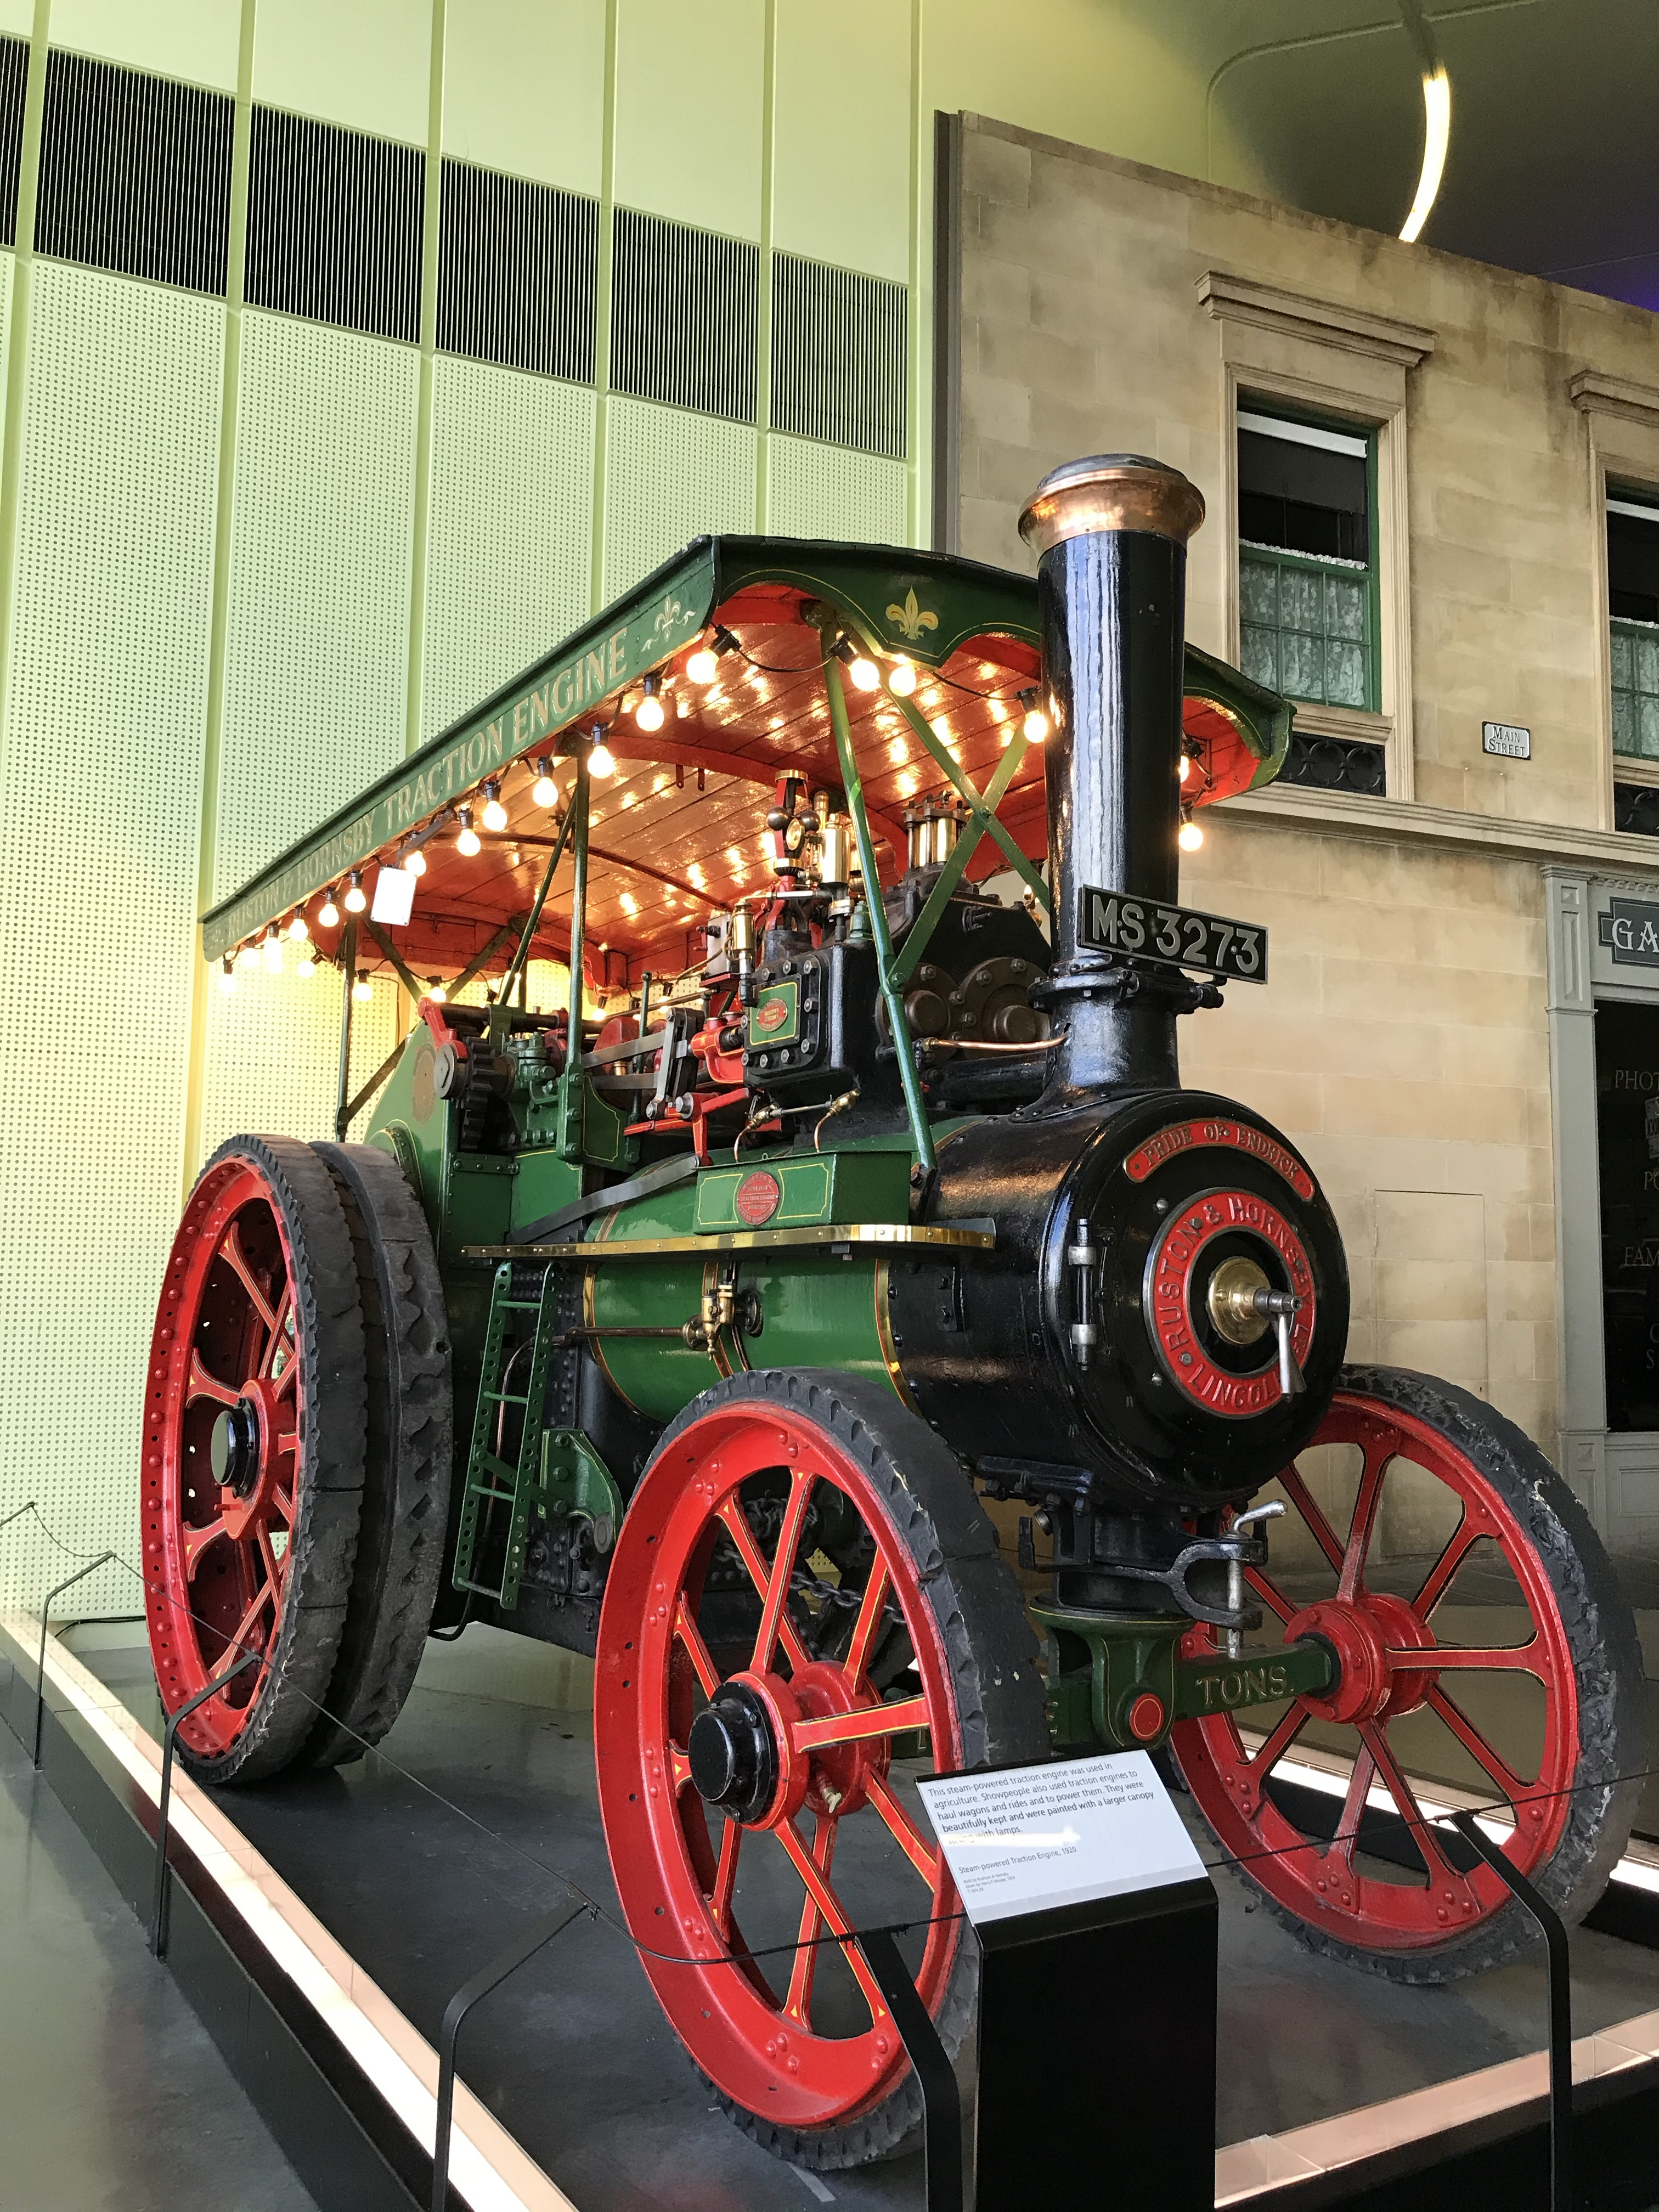
The Magnificent
Traction Engine
From 1920
This traction engine is featured
in our Travelling Show People
Display.
Please click on the
volume icon to hear audio

Slide 8
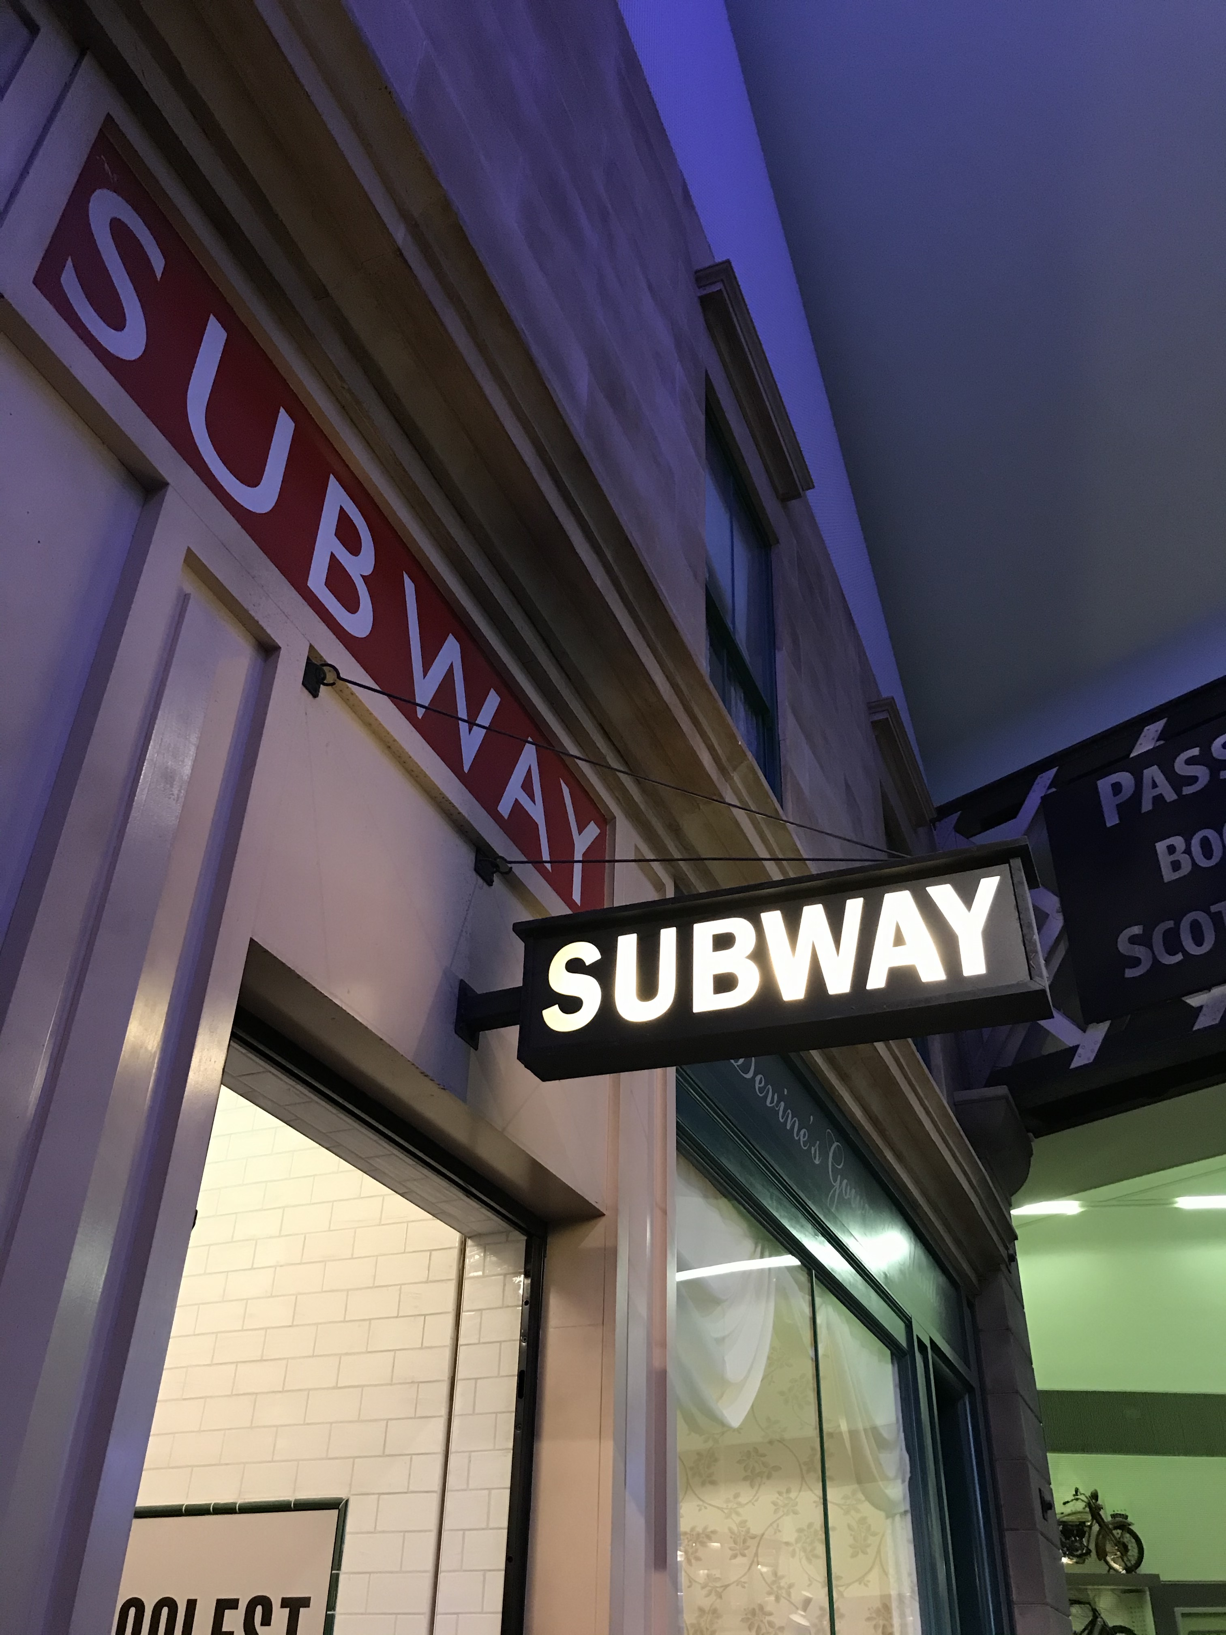
The Subway
on Main Street
Please click on the
volume icon to hear audio

Slide 9
you have reached the end of the presentation, we hope you have enjoyed it
&
We look forward to welcoming you in person in the
Future

