Slide 1


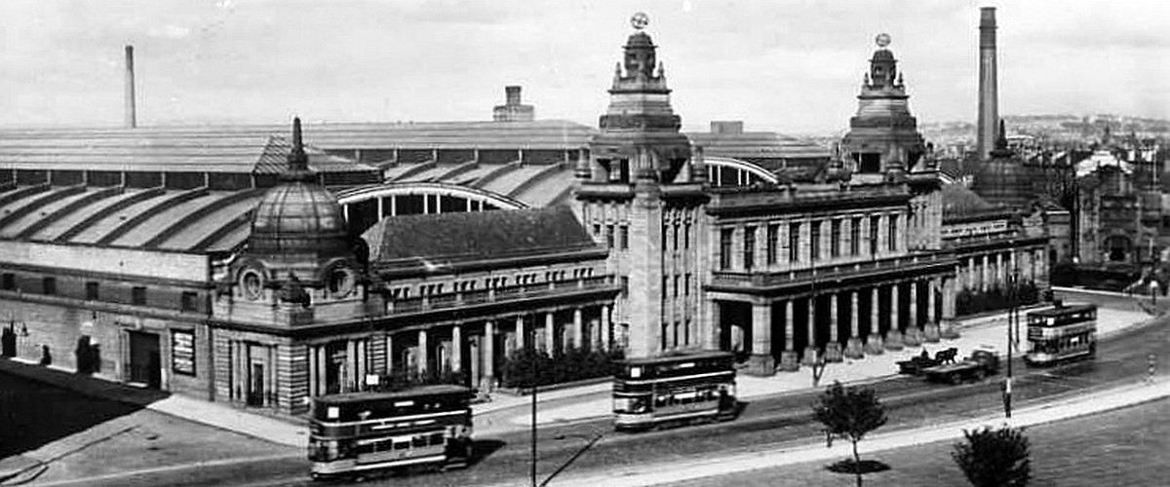
Kelvin Hall Memories
A look back at the history of this famous Glasgow building.

Slide 2
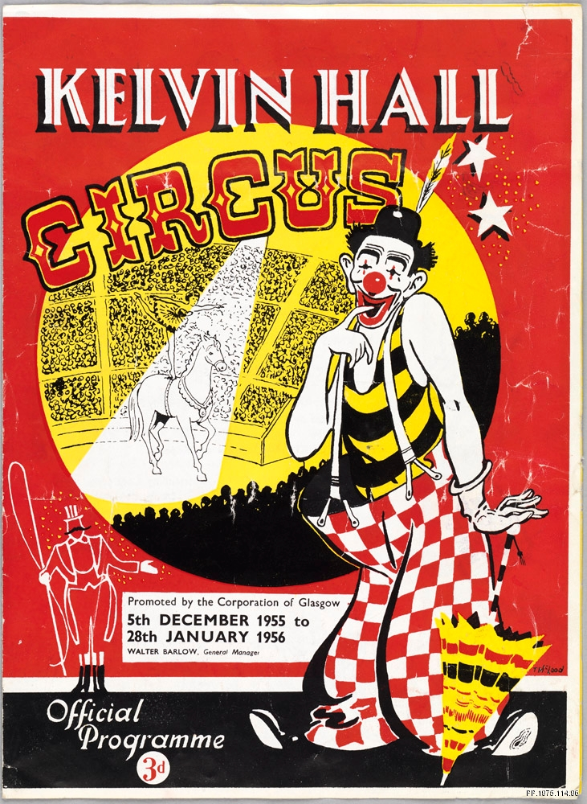
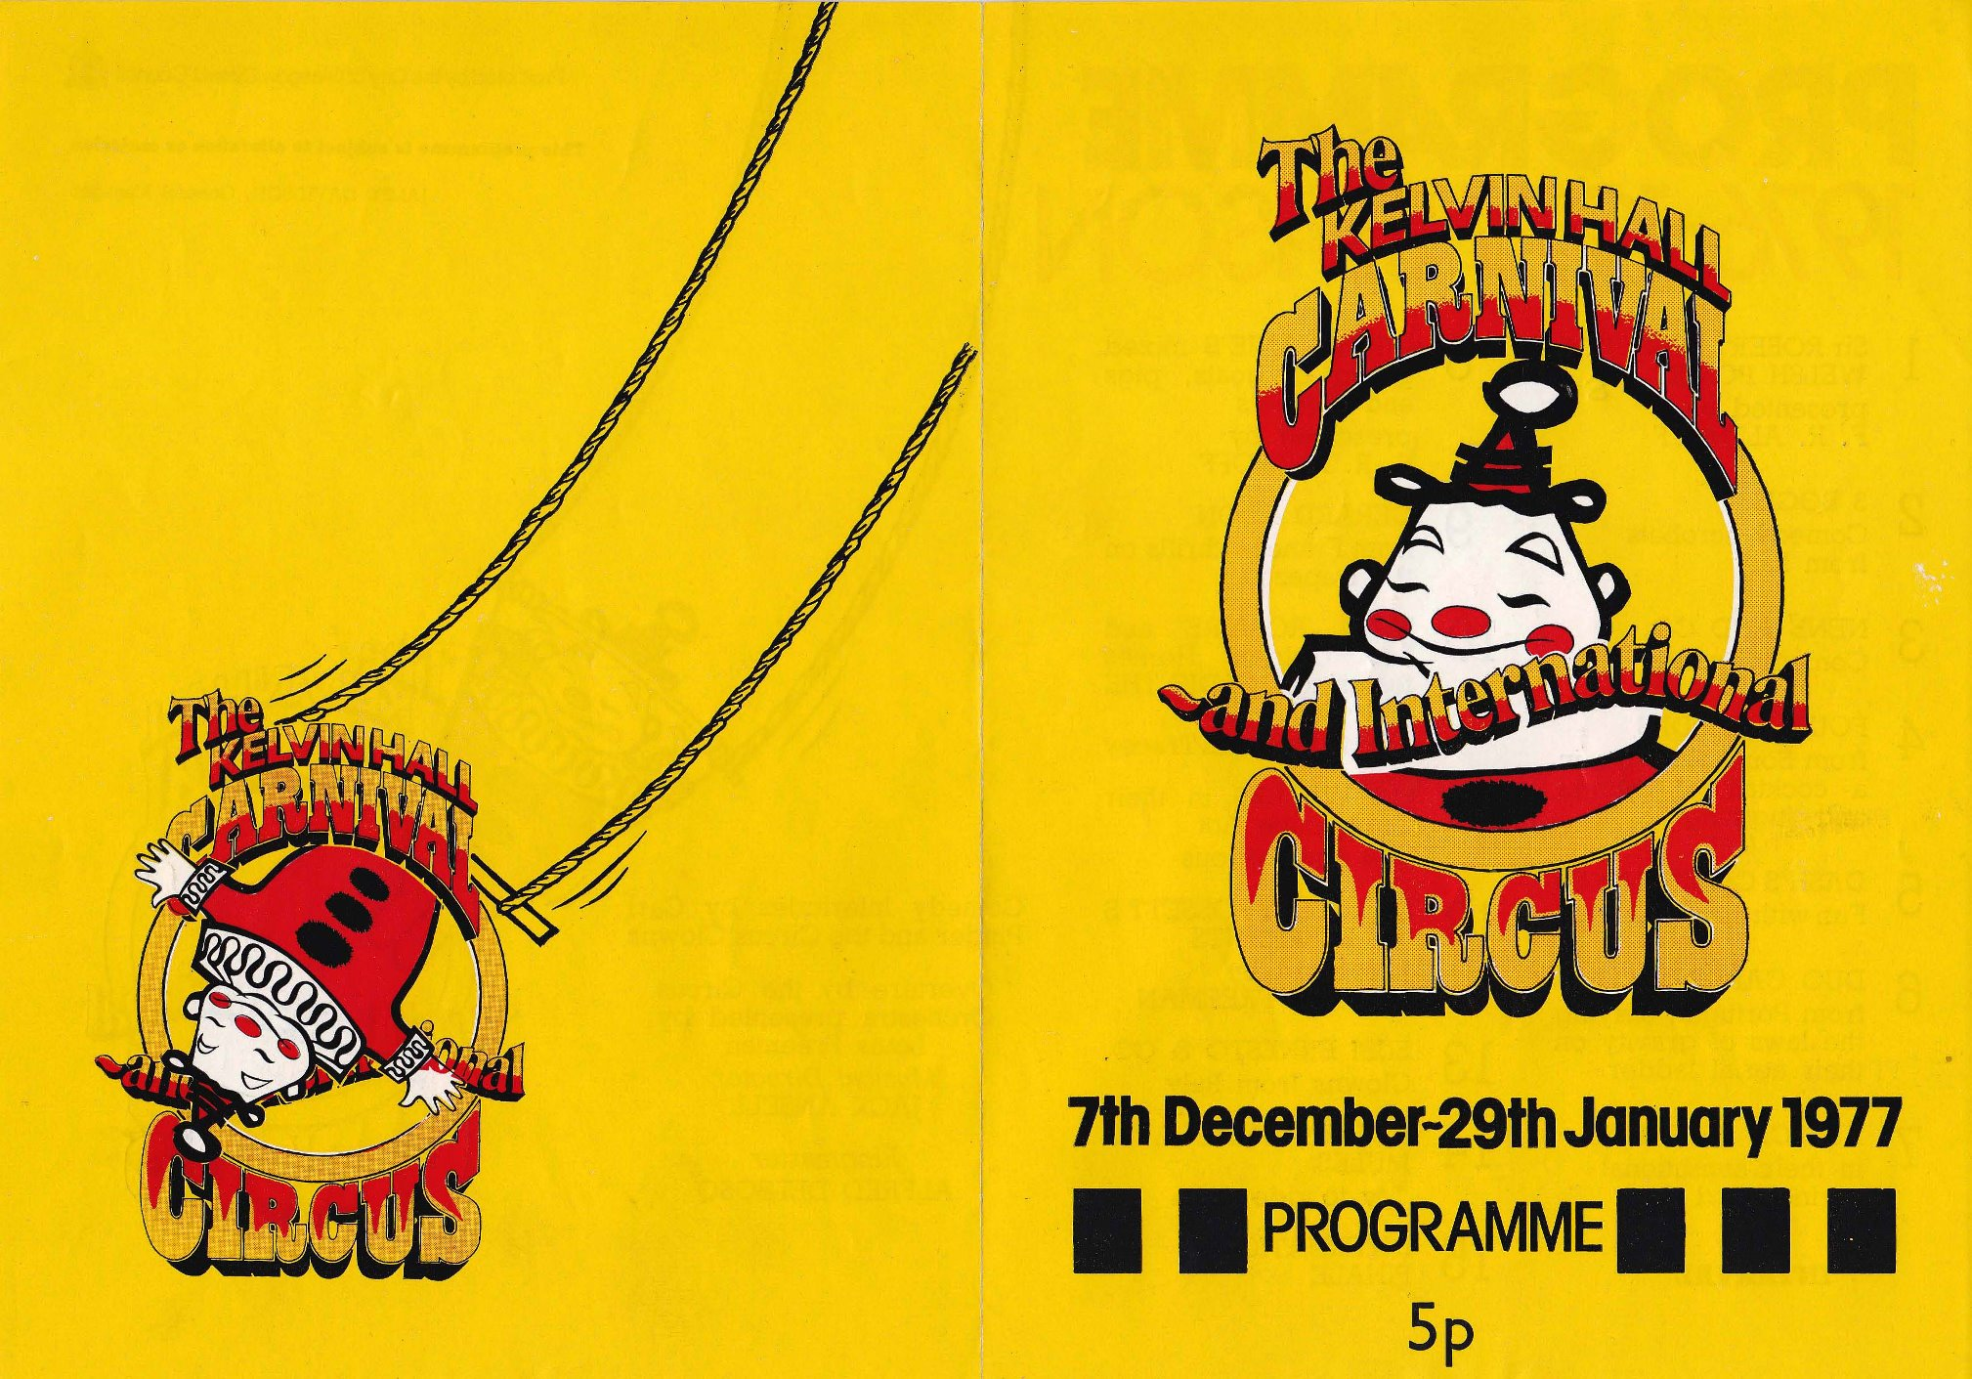
Let’s start by looking at the famous annual Circus and Carnival!

Slide 3
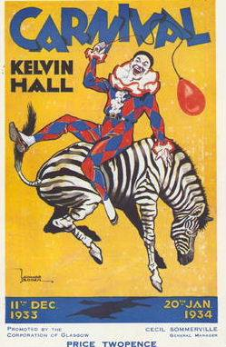
The Circus and Carnival
The annual circus and carnival was held at Kelvin Hall from 1924 until 1985 when the building was then converted to house the Museum of Transport, which opened in 1987.
Many visitors to Kelvin Hall today say that when they think of going to the circus when they were younger, the smell of the elephant dung is the thing they remember the most!
Let’s look back at some of the action!

Slide 4
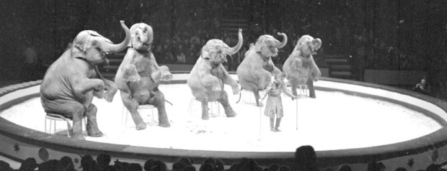

Films of the Circus
The following films are part of the National Library of Scotland’s Moving Image Archive, at Kelvin Hall. The first film shows animal performing and the second film shows acrobats.
https://movingimage.nls.uk/film/3193/74960075
https://movingimage.nls.uk/film/T0096/74958764
Notes:
Link for films:
https://movingimage.nls.uk/film/3193/74960075
https://movingimage.nls.uk/film/T0096/74958764
From home movies to documentaries, from industry to entertainment - the National Library of Scotland Moving Image Archive (formerly the Scottish Screen Archive) has something for everyone.
Explore around 100 years of Scotland's history captured by amateur and professional film-makers. Here in the Moving Image Archive catalogue you will find details of thousands of films and videos held at the Library which you can watch with your group.

Slide 5
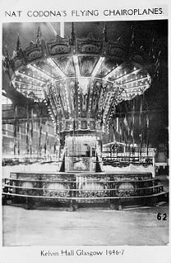
Carnival on Film
This next film, also from the National Library of Scotland’s Moving Image Archive, is called Xmas Lights and features some scenes of the Kelvin Hall Carnival with rides including the dodgems, Ferris wheel and the merry-go-round, and sideshows, stalls and games. It was filmed in 1969 and is silent. Do you know the rule when watching silent films? You must talk about what’s happening in it!
https://movingimage.nls.uk/film/2187
Notes:
Silent film of the Carnival: https://movingimage.nls.uk/film/2187 start the film at 13:54
Additional film of showpeople and visitor to the carnival sharing their memories of the carnival: https://vimeo.com/177225995

Slide 6
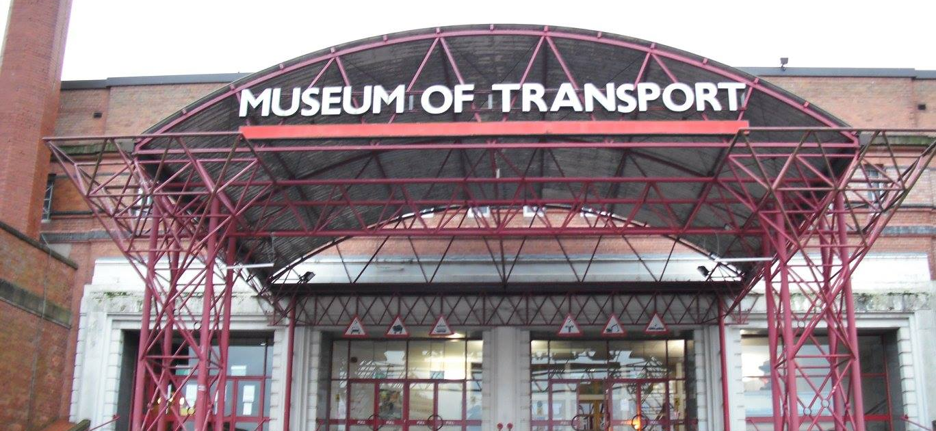
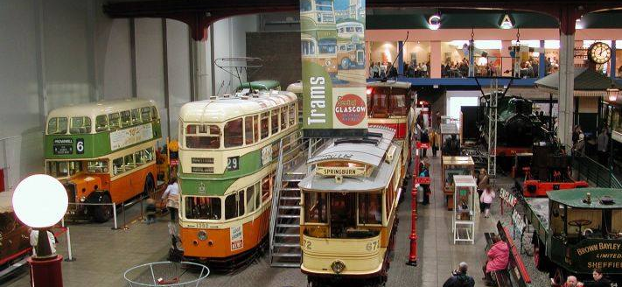
The Museum of Transport
From 1987 until 2010, Kelvin Hall was the home of the Museum Of Transport, housing an enormous collection of railway locomotives, cars, trams, fire engines, motorcycles, buses and even prams!
Let’s take a look at what was inside.

Slide 7
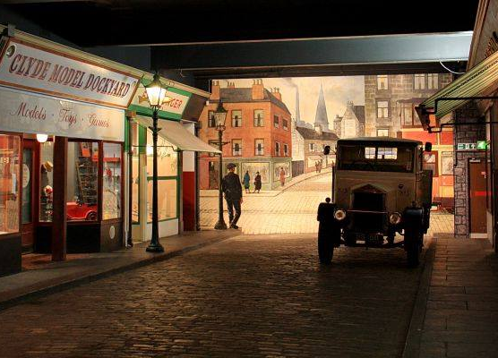
‘Kelvin Street’ with
its range of shops, Regal Cinema
and full-scale recreation of a
pre-1977 Glasgow Subway station featuring salvaged objects from the
old Merkland Street Subway station.

Slide 8
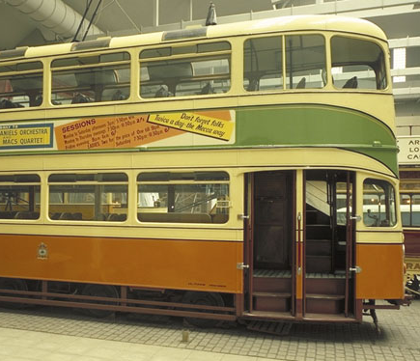
Here we have a Glasgow Corporation Transport ‘Cunarder’ tramcar dating from 1952.
The sign on the front of the tram is for Finneston.
It was the last double decker tram built in the UK.

Slide 9
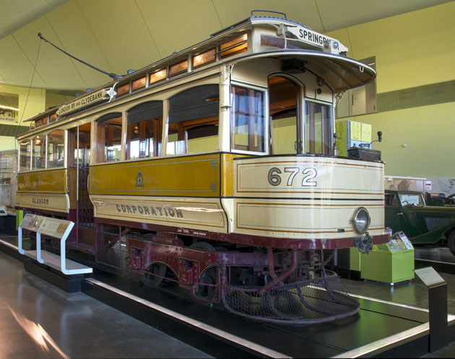
This type of tram was known as a Room and Kitchen because it resembled a typical Glasgow tenement
flat.
It is an example
of the first electric tramcars used in Glasgow. It has a single deck and dates from around 1900.

Slide 10
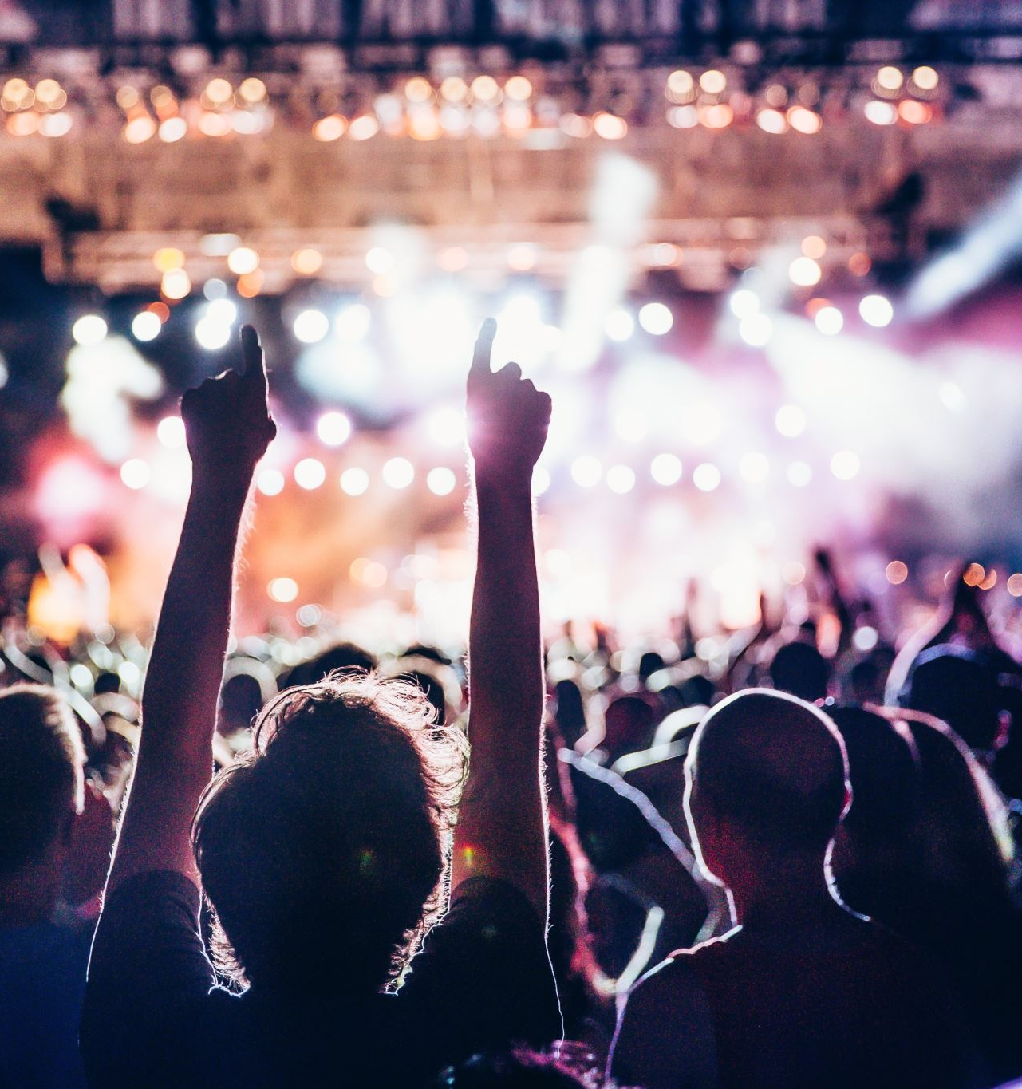
Music at Kelvin Hall
Kelvin Hall has played host to many concerts over the years from pop and rock, to country and even classical music!
The next few slides are just a taster of some of the acts who have performed here. So get your dancing shoes on and enjoy our mini Kelvin Hall concert!

Slide 11


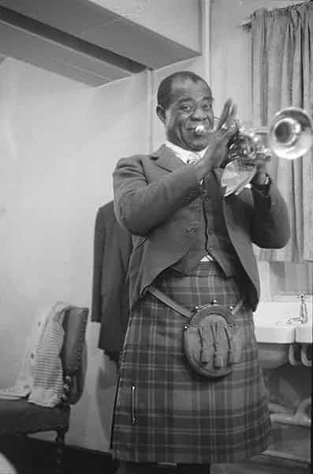
Let’s start our concert with the first ever music artist to play at Kelvin Hall – Louis Armstrong.
Ol’ Satchmo made his Glasgow debut in 1956 and during his visit even asked to be fitted for a full dress kilt outfit!
Feel free to dance or sway along to his most famous song – What a Wonderful World!
Notes:
Link to video: https://www.youtube.com/watch?v=A3yCcXgbKrE

Slide 12

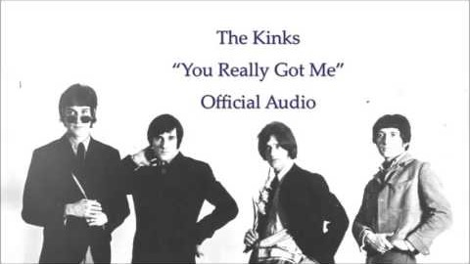
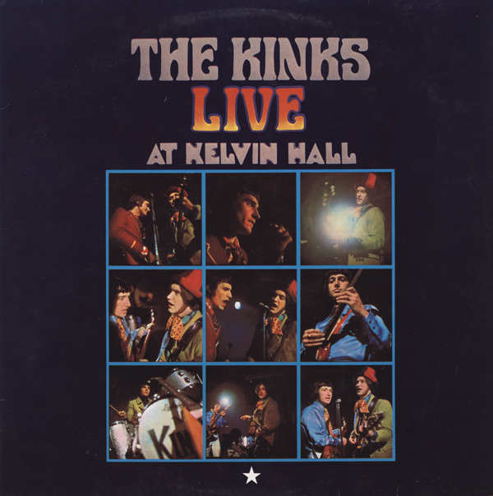
Let’s up the tempo for our next song!
The Kinks recorded their first live album at Kelvin Hall on 1st April 1967. Reviews of the album focused mainly on the noise of the Glasgow crowd which can be heard throughout the recording!
Notes:
Link to video: https://www.youtube.com/watch?v=fTTsY-oz6Go

Slide 13
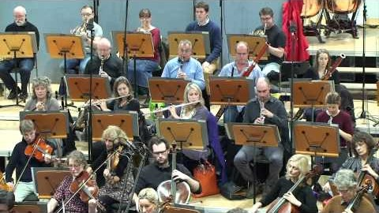
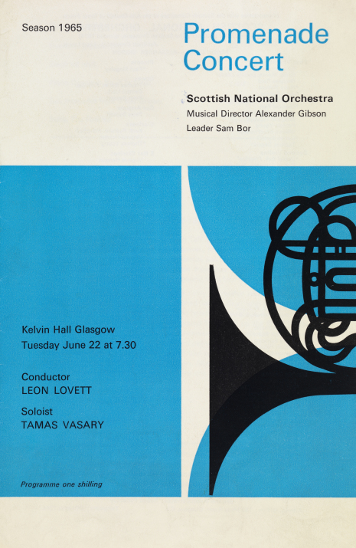
Pop and rock music were not the only sounds to be heard in Kelvin Hall. The Scottish National Orchestra played several seasons of Proms here between the early 60s and the 1980s.
The Queen became their patron in 1977 which prompted a name change in 1991 to the Royal Scottish National Orchestra.
This video shows the RSNO playing the overture to the Barber of Bagdad by Peter Cornelius.
Notes:
Link for video: https://www.youtube.com/watch?v=X4sutGFB9h8
Activity: Get your imaginary conductor’s batons out and have a go at conducting the RSNO

Slide 14
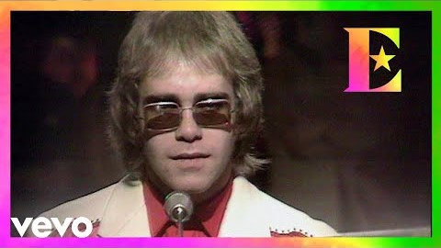
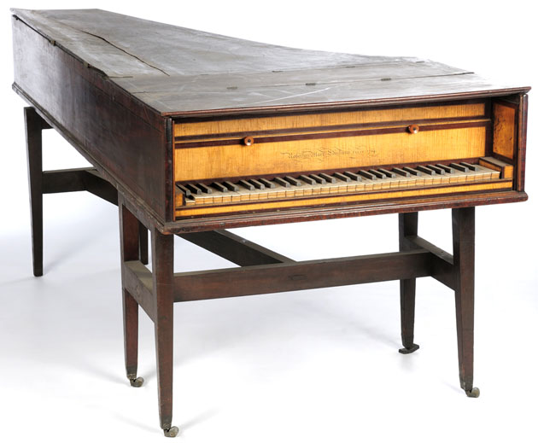
Elton John played Kelvin Hall in April 1972, the same year as released his 5th studio album in the UK Honkey Chateau which featured the hit song Rocket Man.
This song, ‘Your Song’ was released two years earlier and was featured on the setlist for the gig at Kelvin Hall. There is also a 7” vinyl single of the song in the Kelvin Hall store.
Notes:
Link to video: https://www.youtube.com/watch?v=GlPlfCy1urI
Additional questions:
How do you listen to music today?
Has the way we listen to music changed over the years?
Can you play a musical instrument, or was there one that you wanted to learn?
If you would like to play a more upbeat Elton John song, here is a link to Crocodile Rock: https://www.youtube.com/watch?v=B8dqdRDCLB4 (03:38)
The video shows him playing the song at the London Palladium in 1972, so the band set up probably would’ve been similar to his concert at Kelvin Hall. There is also a 7” single of Crocodile Rock stored at Kelvin Hall.

Slide 15
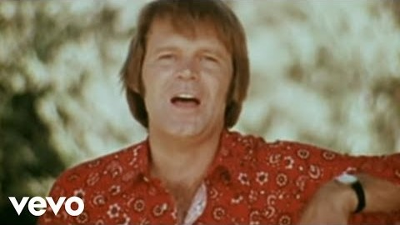
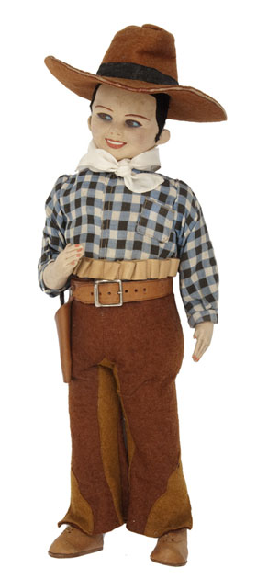
Let’s finish our mini concert with a country classic!
Glen Campbell played Kelvin Hall in April 1975. A month later he released one of his most famous songs, Rhinestone Cowboy.
Notes:
Link for video: https://www.youtube.com/watch?v=8kAU3B9Pi_U
The Cowboy Doll pictured is held in the Glasgow Museums store at Kelvin Hall.
What do you think it is made of?
How old do you think it is?
How do you think it was made?
If you owned it, where would you put it?

Slide 16
Glasgow Museums Objects References
Object: Publicatation Place Associated, Scotland, Glasgow, Kelvin Hall Date: 1955-56 Materials: paper ID Number: PP.1975.114.96 Location: In storage | Object Type: Tramcar Place Associated: Scotland, Glasgow Date: 1898 Materials: metal, glass, wood, plastic ID Number: T.1964.35.b Location: Riverside Museum Main Exhibition Area | Object Type: Doll Place Associated: United States, Texas Date 20th Century Materials: Cloth, leather, wood ID Number: A.1950.15.ba Location: In storage
Object Type: Tramcar Place Associated: Scotland, Glasgow Date: 1952 Materials: metal, glass, plastic, leather ID Number: T.1972.33 Location: Riverside Museum Main Exhibition Area | Object Type: Piano Place Associated: Scotland, Edinburgh Date: 1794 Materials: wood, ebony, ivory, fel;t, wire, metal ID Number: 1912.28.1 Location: In storage

Slide 17
Additional Information
Kelvin Hall Website
https://kelvinhall.org.uk/
National Library of Scotland Moving Image Archive
https://movingimage.nls.uk/
Glasgow Museums Collections Online
https://www.glasgowlife.org.uk/museums/collections

