Slide 1
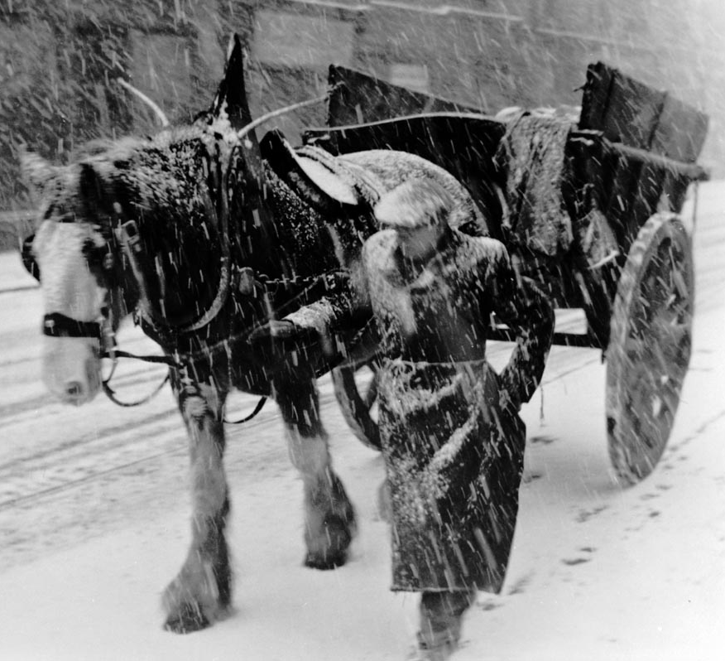
Palace Winter Wonders
Warm yourself up with a trip down memory lane.
Notes:
Image: Photograph of "A Dying Mode of Transport" A horse and cart in winter snow storm" taken for the Glasgow Photographic Survey 1955, taken by Alf Daniel. ID Number: OG.1955.121.286, location: in storage.
Questions for this image:
Who do you think the man in the photo is? (rag and bone man)
Do you remember the rag and bone man coming round?
Did he give you anything in return for your old things? (a balloon maybe)

Slide 2
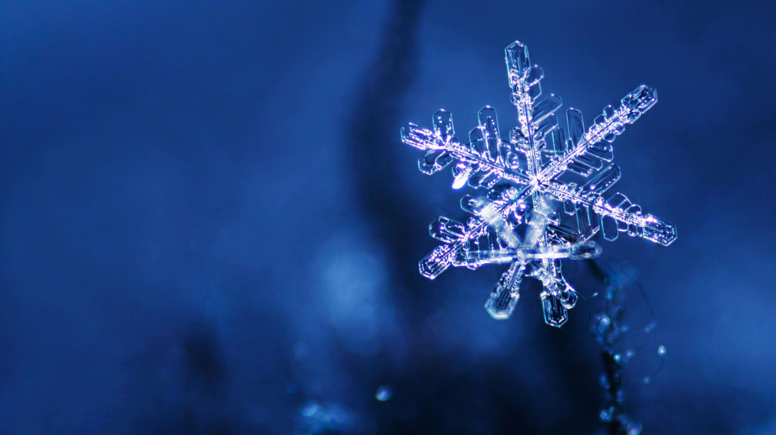
Words for Wintry Weather!
Jeelit
Fret
Flaggie
Feefle
Snell
Spitters
Oorlich
Flindrikin
Gandiegow
What others can you think of?
Notes:
Gandiegow: A squall. A sudden violent gust of wind usually bringing rain or sleet.
Spitters: Small icy droplets or snowflakes that are blown in on the wind.
Flindrikin: A baby snow shower. Aww.
Feefle: A magical, happy kind of snow shower with swirling snowflakes in the air.
Oorlich: A word not used nearly enough which includes a hearty mix of damp, nippy, cold and chilly weather all in one go.
Jeelit: Brr! To feel ‘fair jeelit’ is to feel as cold as ice.
Fret: A super chilly and damp mist that comes in off the sea.
Flaggie: A very large snowflake.
Snell: So bitterly cold it feels as though the air is piercing your skin with lots of tiny needles.

Slide 3
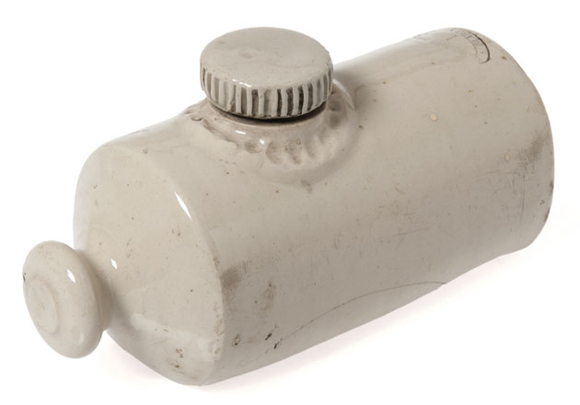
Mystery Object!
Here is part of an object from the Glasgow Museums Collection.
Can you guess what it could be?
Here’s a clue – it kept you warm.

Slide 4
It’s a Hot Water Bottle!
Did you have one of these to keep you warm during the winter nights?
Some people called them a Stone Pig.
Did you have a different name for it?
Notes:
Object type: hot water bottle
Artist/Maker: Govancroft Pottery maker
Place Associated: Scotland, Glasgow, Govancroft Pottery (place of manufacture); Scotland, Glasgow, Port Dundas (place associated)
Date:1920-1950
Materials: stoneware
Dimensions: overall: 115 mm x 224 mm x 95 mm 1373.5 g
Description:Cream coloured ceramic hot water bottle, cylindrical shaped with a flat back tapering to a narrow neck with bulbous top, circular shaped screwable lid on top section, makers mark stamped on top reads, ‘Govancroft Pottery Glasgow 1’.
ID Number: PP.1978.40.2
Location:In storage

Slide 5
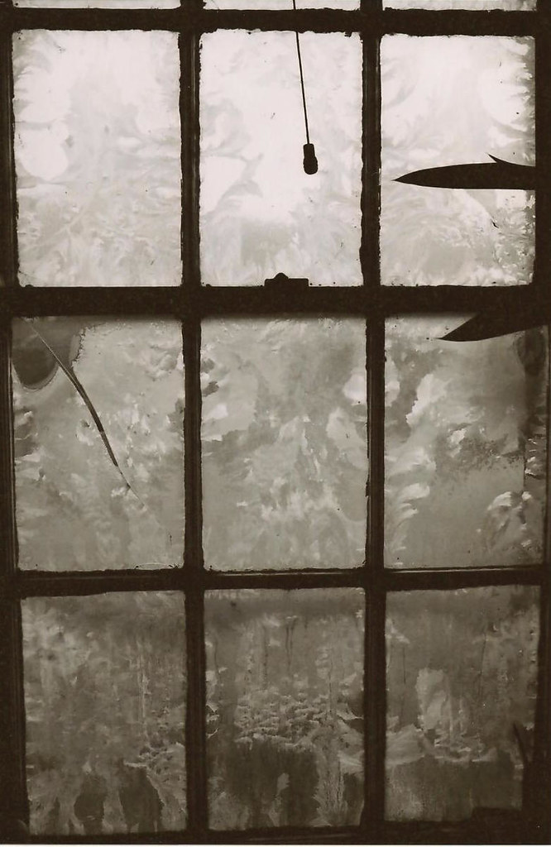
Baby, it’s cold outside!
Windows frozen on the inside – just one of the joys of living in a tenement in the winter!
How did you keep warm when the outside was practically inside?!
This Photo by Unknown Author is licensed under CC BY-NC-ND

Slide 6
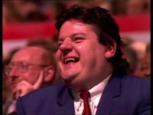
Coats on the bed!
Watch the clip from An Audience with Billy Connolly
Does this bring back any memories?
Notes:
Click ‘enable content’ on the bar above the PowerPoint slide and make sure that Internet Explorer is enabled. Press play. Stop the video at 28:50.
Link for the clip if the embedded video doesn’t work: https://www.youtube.com/watch?v=f1LJjNIWSDs&pbjreload=101
Start the video at 26:20.

Slide 7
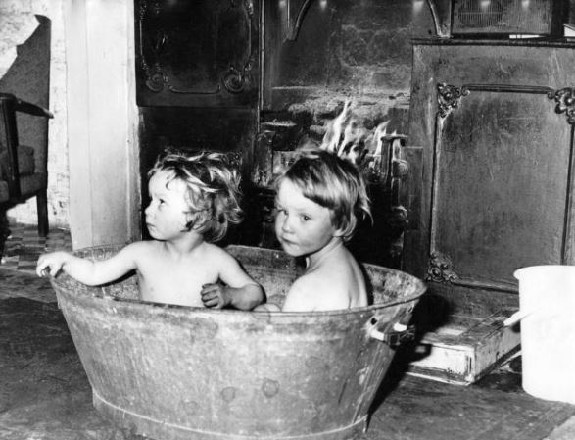
Don’t throw the baby out with the bath water!
What about a bath in front of the fire in wintertime – did anyone have a tin bath?
Did you have to share the bath water?
Was it cold by the time it was your turn?

Slide 8
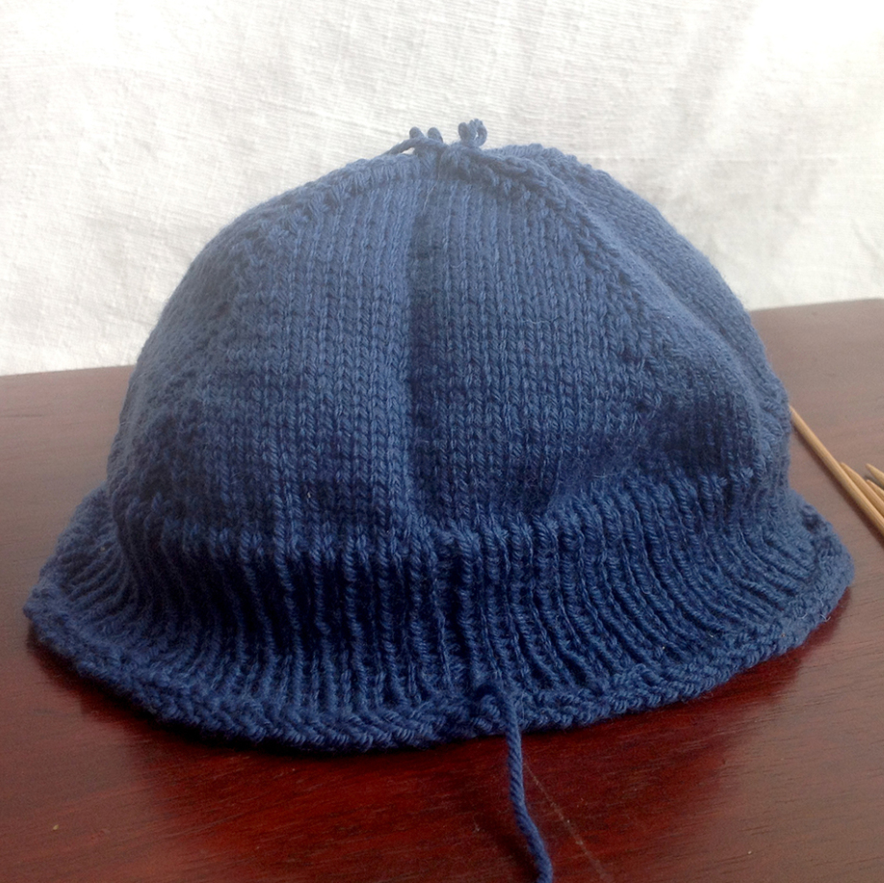
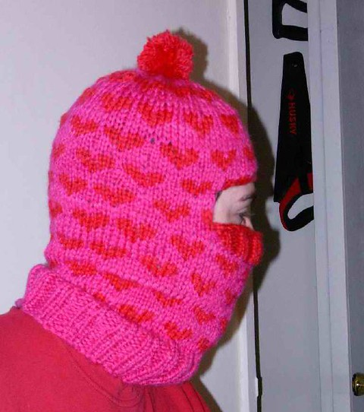
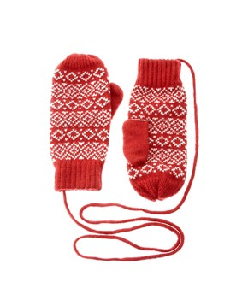
Winter Warmers
Did you have any homemade woollies like these to keep you warm in winter?
Who knitted them for you? Were they comfortable to wear or were they scratchy?!
This Photo by Unknown Autor is licensed under CC BY-SA-NC
This Photo by Unknown Author is licensed under CC BY
This Photo by Unknown Author is licensed under CC BY-SA
Notes:
Photo References:
Balaclava: This Photo by Unknown Author is licensed under CC BY-SA
Mittens: This Photo by Unknown Author is licensed under CC BY
Hat: This Photo by Unknown Author is licensed under CC BY-SA-NC

Slide 9
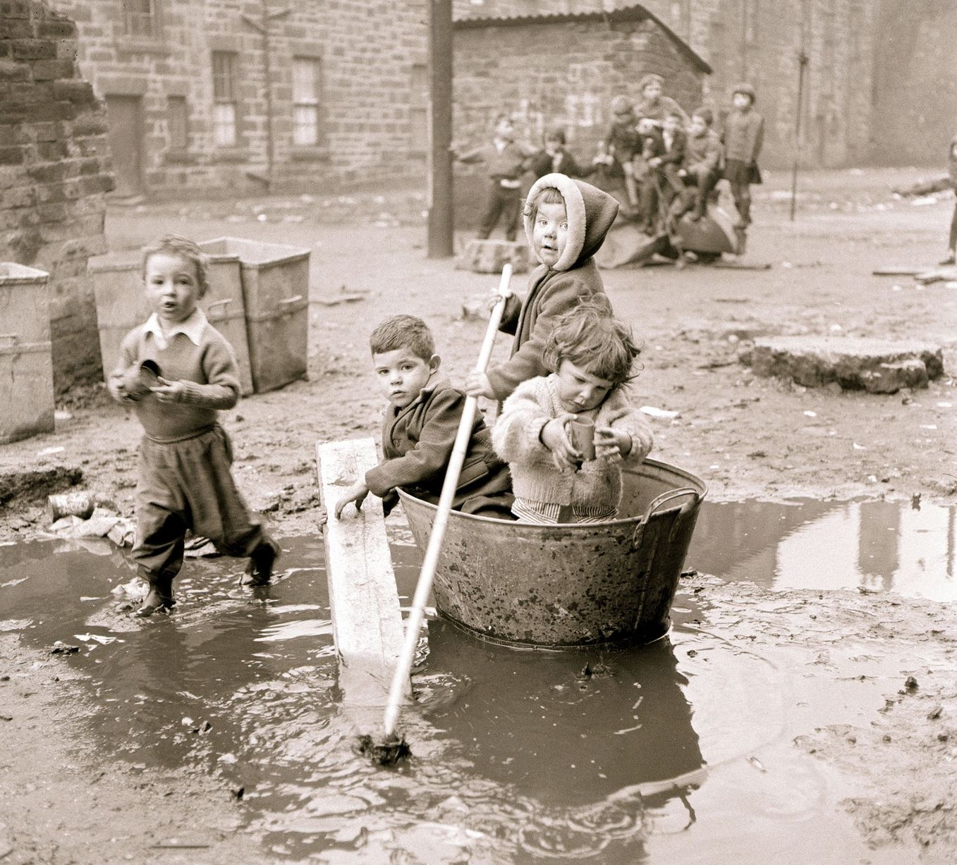
Playing outside in the puddles!
What can you see in this picture?
Did you play outside in all weathers?
What’s the small brick building in the background?
Did anyone have to use one in the cold weather? What was it like?!

